Slide 1
The Battle of Neighbourhoods
Capstone Project

Slide 2
Introduction/Business Problem
Background of Problem
The central business district of Toronto, Ontario is Downtown Toronto & is located entirely within Old Toronto district. It covers approximately 14 sq kms in area, whereas to its north, south, east & west are bounded by Bloor Street, Lake Ontario, the Don Valley, & Bathurst Street respectively. The Government of Ontario and the City of Toronto government are also located here.
After Newyork City & Chicago, Canada's Downtown Toronto stands on third position in North America because of most skyscrapers; with height more than 200 meters. This area also comprises of largest business centres along with largest skyscrapers and form's Toronto's skyline.
Because of being largest business centre and having major government offices located in this area, this area offers a lot of various business opportunities to new entrepreneurs.
Description of Problem
As a Data Scientist I have been hired by my client, who runs a successful Asian cuisine restaurant in Asia, to investigate how many restaurants offer Asian cuisine in Downtown Toronoto, so that he can expand its operations in Europe. Because of the diverse population of Canada as a lot of people migrate there, my client aims to introduce Asian flavour in that area with a hope to be successful.
Target Audience
As a result of a lot migration to Canada from various parts of the world,the diversity of Canada has resulted in a very high multicultural environment.In the search for an high-end Asian-inclined eat-outs, there seems to have high shortage.
Data description
Data¶
Down Town, Toronto will be analyzed in project. Wikipedia and Foursquare will be used to pull data for analysis

Slide 3
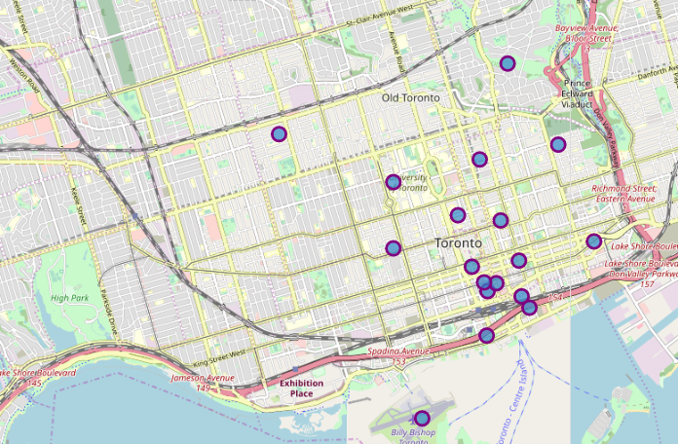
Methodology
The basic goal of this analysis was to help my client; who is operating an Asian restaurant, identify a good location in Downtown Toronto for his expansion of operations in Europe.
Data was scraped from Wikipedia, cleaned and filtered down to Downtown.
Downtown has 36 neighbourhoods and 17 postcodes.

Slide 4
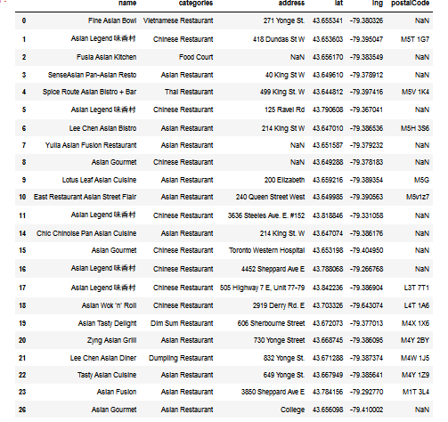
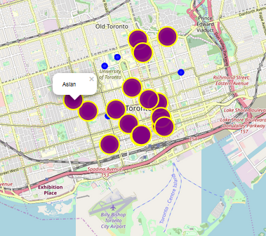
Methodology (contd)
With the help of Foursquare I was able to explore eating venues in Downtown Toronto. The total count of restaurants that exist in all of the Downtown area is 26. including Chinese, Asian, Thai, Vietnamese restaurants.

Slide 5
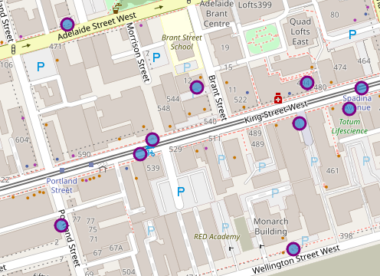
Methodology (contd)
From this data table and map I was able to analyze and pick my sample for analysis of the area.
I picked Spice Route Asian bistro +bar, which is a Thai restaurant as a center point and analyzed its surroundings with top 10 venues within 1000 meter of this point.
Surprisingly, the top 10 venues that were pulled does not had any Asian restaurant in the list.

Slide 6
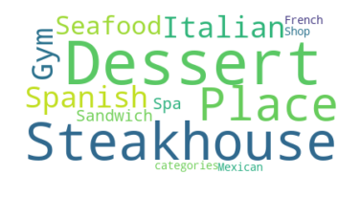
Afterwards , with the help of Foursquare I tried to pull the rating of these top 10 venues but sadly no rating information was available for these venues so, with the help of Word Cloud I was able to identify most popular venue among these which appeared to be Italian and Spanish eat-outs.

Slide 7
Results & Conclusion
The results of this analysis clearly state that , it is a wonderful opportunity for my client to expand its operations in Downtown, Toronto – poste code M5V, as there is no Asian cuisine outlet that serves Asian food there.

